Slide 1

PROJECT TITLE SECURE DATA HIDING IN IMAGE USING STEGANOGRAPHY
SECURE THE DATA TO PREVENT HACKERS
Student Name : VIVEK KUMAR YADAV, DEEPAK KUMAR YADAV
College Name : BANARSIDAS CHANDIWALA INSTITUTE OF INFORMATION TECHNOLOGY, Dr. AKHILESH DAS GUPTA INSTITUTE OF PROFESSIONAL STUDIES
Department: MCA, B.TECH CSE

Slide 2
OUTLINE
Problem Statement
Technology used
Wow factor
End users
Result
Conclusion
Git-hub Link
Future scope

Slide 3
Problem Statement
This project focus on concealing sensitive information within images to ensure confidentiality. It uses steganography techniques to embed data without noticeable image distortions making detection difficult . It uses enhances security by encryption & efficient encoding methods for secure communication and data protection against unauthorized access.

Slide 4
Technology used
The Libraries used are: a) Built-in Python Libraries:
base64 – Encoding and decoding binary data to/form Base64.
json – Reading and writing JSON file.
os – Interacting with operating system(e.g., file paths).
time – Measuring execution time.
datetime – Handling Timestamps.
tkinter – GUI toolkit for building the application interface.(Tk, Entry, Label, Button, filedialog, messagebox, ttk, StringVar, Text, Scroolbar, Canvas)
b) Third-Part Libraries:
pycryptodome – Used for AES encryption and Decryption.
pyinstaller – For creating an “.exe” file.
Platform used is Python Shell (IDLE).

Slide 5
Wow factors
✅ Dual-Layer Security – AES-256 + Steganography to hide encrypted data in files without detection.
✅ User-Friendly GUI – Tkinter-based interface with multi-tab navigation & interactive popups.
✅ Activity Logging – Tracks encryption/decryption actions with timestamps for security insights.
✅ User Authentication – Login system with credential updates via a config file.
✅ Portable .EXE – Runs on any Windows PC without requiring Python installation.
✅ Smart File Handling – Prevents corruption by keeping original files safe.
✅ Professional Touch – Custom branding & watermark for a polished look.
✅ Supports Multiple File Types – Encrypts & hides data in images, audio, video, PDFs, and DOCX files

Slide 6
End users
✅ Cybersecurity Enthusiasts & Professionals – Securely store and transmit sensitive information.
✅ Journalists & Activists – Protect confidential documents and communications.
✅ Businesses & Corporations – Encrypt sensitive company data without complex software.
✅ Students & Researchers – Learn encryption & steganography concepts through a practical tool.
✅ General Users – Securely hide private messages or files from unauthorized access.

Slide 7
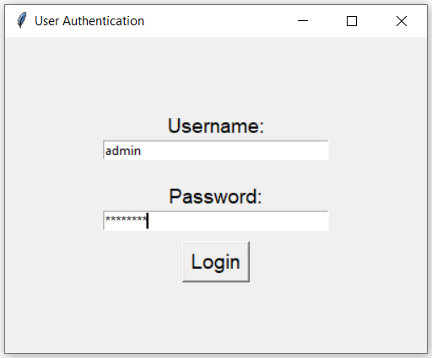
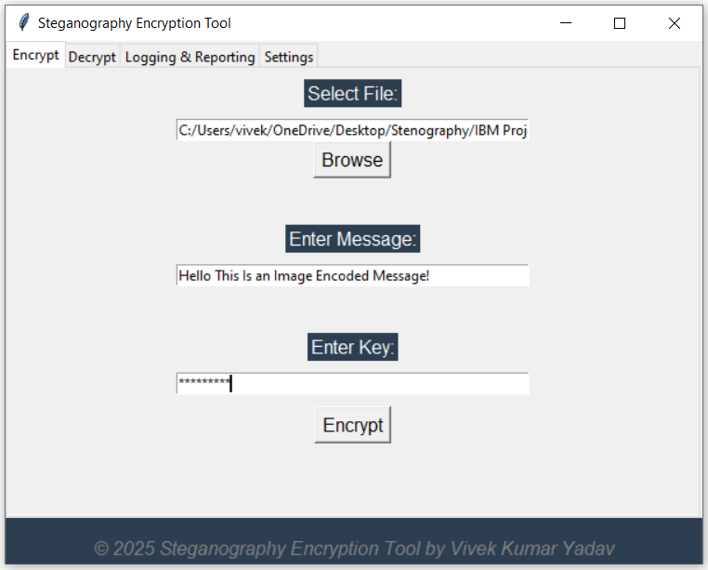
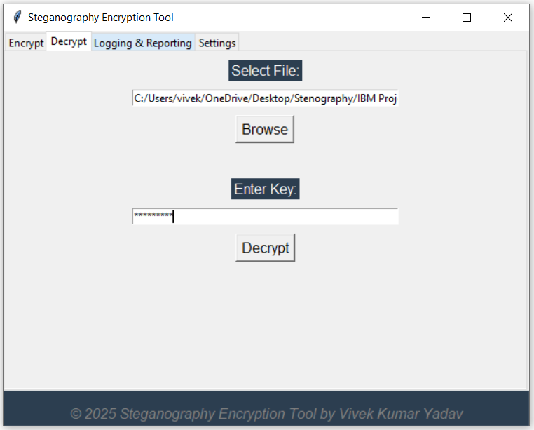
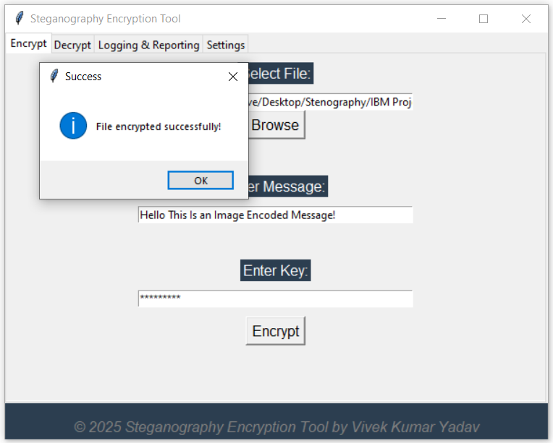
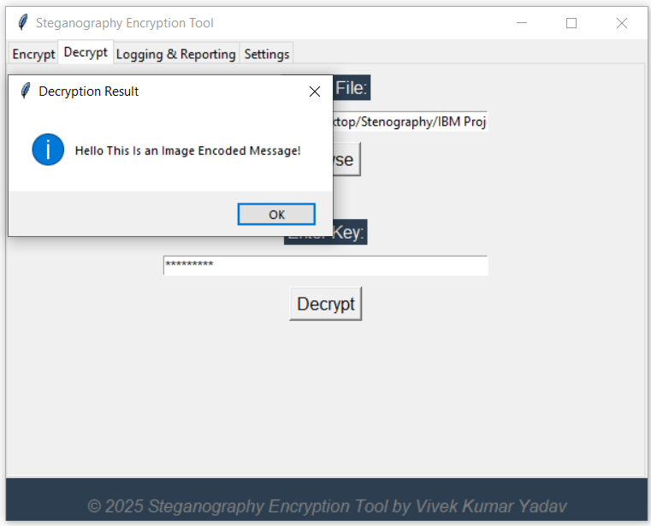
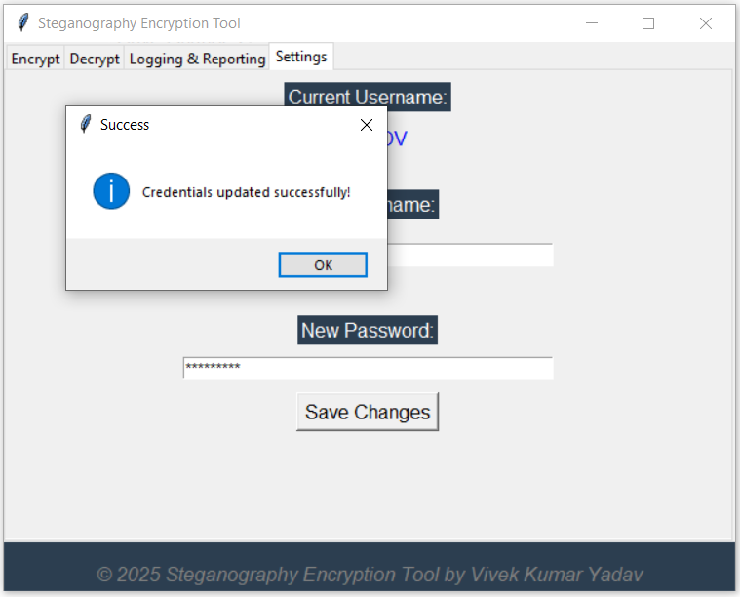
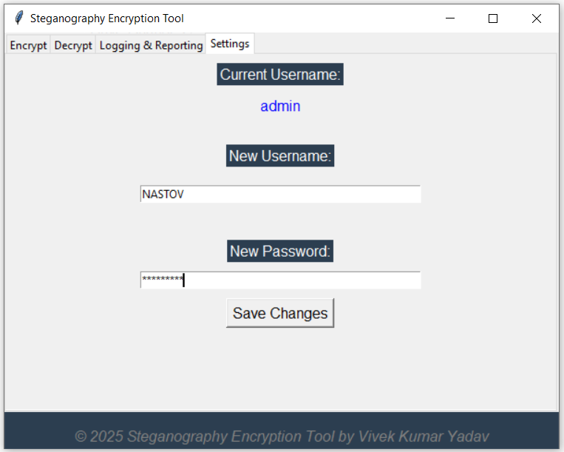
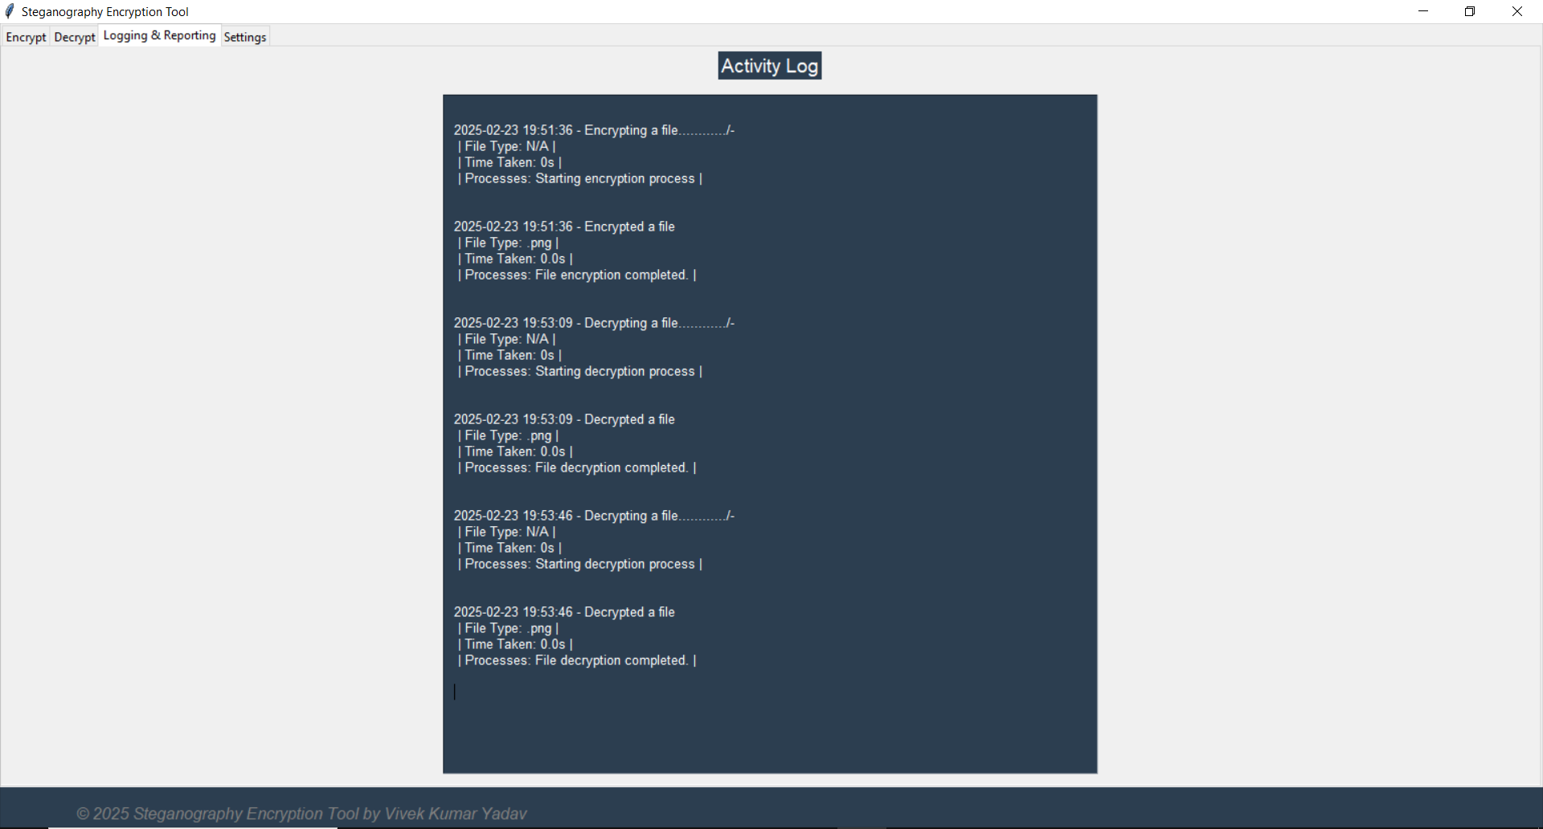
Results

Slide 8
Conclusion
This project successfully addresses the challenge of secure data concealment and encryption by combining AES-256 encryption with steganography.
It provides a user-friendly GUI for encrypting and embedding sensitive data into multiple file formats (images, audio, video, PDFs, and DOCX) while ensuring strong security, portability, and ease of use.
The integration of authentication, activity logging, and smart file handling enhances its reliability, making it an effective solution for individuals and organizations looking to protect their confidential data.
Additionally, the portable .exe format allows users to run the application without installing Python, making it accessible to a wide range of users, including cybersecurity professionals, journalists, and businesses handling sensitive information.

Slide 9


GitHub Link
https://github.com/NASTOV03/StegoShield-Project.git

Slide 10
Future scope
AI-Powered Steganalysis Resistance: Implement machine learning techniques to make detection-resistant steganography. Improve payload capacity while ensuring undetectability.
Cloud-Based Steganography Platform: Develop a web-based version for secure online data hiding and retrieval. Enable secure file sharing through cloud storage encryption.
Blockchain Integration for Data Integrity: Use blockchain to verify and track encrypted data transactions. Ensure tamper-proof logs for secure steganographic communication.
Multi-Layer Encryption for Ultra-Secure Communication: Introduce asymmetric encryption (RSA) combined with AES & steganography. Develop multi-step decryption requiring multiple security keys.
Steganography in Live Streaming & Video Calls: Explore real-time steganographic data transmission in video streams. Develop a secure communication system using hidden frames in live video.

Slide 11
THANK YOU

